Slide 1
A Test Case Suite for Hornlog+ RuleML 1.01
CS6795 Semantic Web Techniques
Team 3:
Zhenzhi Cui
Radhika Yadav
November 13, 2014

Slide 2
Outline
Introduction of:
RuleML
Deliberation RuleML 1.01
Objective
Project work flow
Implementation
Examples
Conclusion
References

Slide 3
Introduction
RuleML:
RuleML is knowledge representation language which is contrived for the interchange of the major kinds of Web rules in an XML format that is uniform across various rule logics and platforms.
It is elucidated as an extensible family of sublanguages and has eclectic coverage
Modular methodology of schemas allows rule interchange with high accuracy

Slide 4
Deliberation RuleML 1.01
Incorporates a family of sublanguages, commencing with Datalog, Hornlog, and other Derivation Rules, and advancing to FOL and beyond
Introduces new options for obtaining a more fine-grained customization of sublanguages
The potential to combine one or more of the Datalog extensions which jointly elucidate Datalog+

Slide 5
Deliberation RuleML 1.01
Existential Rule: In this rule, the "then" part of a rule has existentially quantified variables, as needed for description logics, F- logic and PSOA RuleML, Rule-Based Data Access, etc.
Equality Rule: In this rule, the "then" part of a rule is the "Equal" predicate, as needed for user-defined/'semantic' equality in logics with equality and functional logic programming and this was already allowed in RuleML 1.0.
Integrity Rule: In this rule, the "then" part of a rule is falsity, as an appropriate way to express negative integrity constraints.

Slide 6
Deliberation RuleML 1.01
In Deliberation RuleML 1.01, each of these Datalog+ features can now also be combined with a conjunction (e.g., an "And" of "Atoms", rather than just one "Atom") in the "then" part.
Deliberation RuleML 1.01 permits mixing in the characteristic Disjunctive Datalog feature of disjunction (e.g., an "Or" of "Atoms") in the "then" part.

Slide 7
Objective
In our project, we will construct a test case suite of RuleML 1.01/XML documents
We will generate schemas for sublanguages using MYNG 1.01 tool

Slide 8
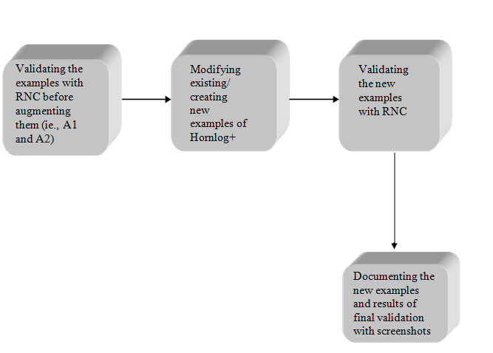
Work Flow

Slide 9
Implementation
Firstly, for lower counter-examples we will remove some features from the Hornlog+ examples and simplify to Datalog+, Hornlog and Binhornlog+.
Then we will add features to develop Hornlog+ examples to Dishornlog+, Nafhornlog+, Neghornlog+ and Nafnegdishornlog+ examples. These are the upper counter-examples but still under the parent category of RuleML 1.01.
The corresponding schemas are created by using the MYNG 1.01 tool by clicking the desired checkbox according to the sublanguage used. The generated schema is then used to validate the example.
Finally, we will document the new examples and counter-examples with their validation results and screenshots.

Slide 10
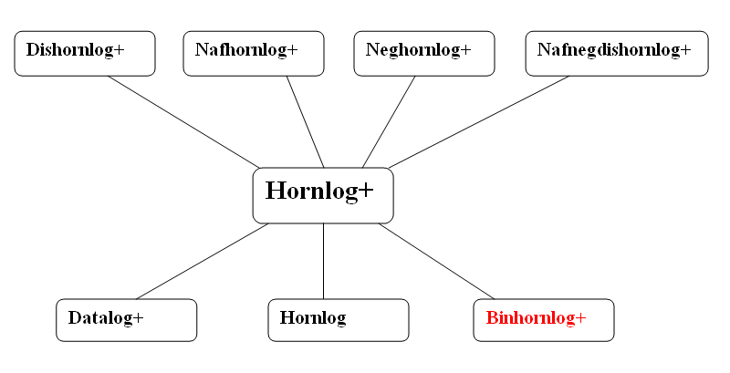
The Hornlog+ Sublanguages In Context
The inheritance diagram of sublanguages that we used for our examples
Hornlog+ with smaller and larger sublanguages
(Binhornlog+ is in red : not- (yet-)-anchor languages are highlighted as such)

Slide 11
Buy.ruleml As A Hornlog+ Example
The validation result for the buy.ruleml document when we validated it with Hornlog+ schema.
The buy.ruleml document
<RuleML xmlns="http://ruleml.org/spec">
<Assert mapClosure="universal">
<Implies>
<if>
<Atom>
<Rel>buy</Rel>
<Var>person</Var>
<Var>merchant</Var>
<Var>object</Var>
</Atom>
</if>
<then>
<Exists>
<Var>retailer</Var>
<And>
<Atom>
<Rel>buy</Rel>
<Var>merchant</Var>
<Var>retailer</Var>
<Var>object</Var>
</Atom>
<Atom>
<Rel>buy</Rel>
<Var>retailer</Var>
<Expr>
<Fun>factoryOf</Fun>
<Var>retailer</Var>
</Expr>
<Var>object</Var>
</Atom>
</And>
</Exists>
</then>
</Implies>
</Assert>
</RuleML>

Slide 12
Buy.ruleml As A Datalog+ Counter-Example
The validation result for the buy.ruleml document when we validated it with Datalog+ schema.
The analysis:
The buy.ruleml document is not only an example for Hornlog+, but also for the upper sublanguages such as Dishornlog+ and Nafhornlog+.
And it is a counter-example for Datalog+, because of the function characteristic.

Slide 13
Buy.ruleml As A Hornlog Counter-Example
The validation result for the buy.ruleml document when we validated it with Hornlog schema.
The analysis:
The buy.ruleml document is a counter-example for Hornlog, because of the Existential characteristic.

Slide 14
Buy.ruleml As A Binhornlog+ Counter-Example
The validation result for the buy.ruleml document when we validated it with Binhornlog+ schema.
The analysis:
The buy.ruleml document is a counter-example for Binhornlog+, because that the <Var> of <Rel>and <Expr> can be zero or more. In Binhornlog+, the <Var> of <Rel> and <Expr> can be zero or two.
The buy.ruleml doucment is not only counter-example for Datalog+, but also for Hornlog and some other lower sublanguages.

Slide 15
Buy1.ruleml As A Dishornlog+ Example
The validation result for the buy.ruleml document when we validated it with Dishornlog+ schema.
The buy1.ruleml document
<RuleML xmlns="http://ruleml.org/spec">
<Assert mapClosure="universal">
<Implies>
<if>
<Atom>
<Rel>buy</Rel>
<Var>person</Var>
<Var>merchant</Var>
<Var>object</Var>
</Atom>
</if>
<then>
<Exists>
<Var>retailer</Var>
<Or>
<Atom>
<Rel>buy</Rel>
<Var>merchant</Var>
<Var>retailer</Var>
<Var>object</Var>
</Atom>
<Atom>
<Rel>buy</Rel>
<Var>retailer</Var>
<Expr>
<Fun>factoryOf</Fun>
<Var>retailer</Var>
</Expr>
<Var>object</Var>
</Atom>
</Or>
</Exists>
</then>
</Implies>
</Assert>
</RuleML>

Slide 16
Buy1.ruleml As A Hornlog+ Counter-Example
The validation result for the buy1.ruleml document when we validated it with Hornlog+ schema.
The analysis:
The buy1.ruleml document is an example for Dishornlog+ and it is a counter-example for Hornlog+, because of the disjunctive head <Or>.
The buy1.ruleml document is not only counter-example for Hornlog+, but also for the lower sublanguages such as Datalog+ and Hornlog.

Slide 17
Buy2.ruleml As A Nafhornlog+ Example
The buy2.ruleml document
The validation result for the buy2.ruleml document when we validated it with Nafhornlog+ schema.
<RuleML xmlns="http://ruleml.org/spec"> <Assert mapClosure="universal"> <Implies> <if> <And> <Atom> <Rel>buy</Rel> <Var>person</Var> <Var>merchant</Var> <Var>object</Var> </Atom> <Naf> <Atom> <Rel>produce</Rel> <Var>merchant</Var> <Var>object</Var> </Atom> </Naf> </And> </if> <then> <Exists> <Var>retailer</Var> <And> <Atom> <Rel>buy</Rel> <Var>merchant</Var> <Var>retailer</Var> <Var>object</Var> </Atom> <Atom> <Rel>buy</Rel> <Var>retailer</Var> <Expr> <Fun>factoryOf</Fun> <Var>retailer</Var> </Expr> <Var>object</Var> </Atom> </And> </Exists> </then> </Implies> </Assert> </RuleML>

Slide 18
Buy2.ruleml As A Hornlog+ Counter-Example
The validation result for the buy2.ruleml document when we validated it with Hornlog+ schema.
The analysis:
The buy2.ruleml document is an example for Nafhornlog+ and it is a counter-example for Hornlog+, because of the feature <Naf>.
The buy2.ruleml document is not only counter-example for Hornlog+, but also for the lower sublanguages such as Datalog+ and Hornlog.

Slide 19
Buy3.ruleml As A Neghornlog+ Example
The buy3.ruleml document
The validation result for the buy3.ruleml document when we validated it with Neghornlog+ schema.
<RuleML xmlns="http://ruleml.org/spec"> <Assert mapClosure="universal"> <Implies> <if> <And> <Atom> <Rel>buy</Rel> <Var>person</Var> <Var>merchant</Var> <Var>object</Var> </Atom> <Neg> <Atom> <Rel>produce</Rel> <Var>merchant</Var> <Var>object</Var> </Atom> </Neg> </And> </if> <then> <Exists> <Var>retailer</Var> <And> <Atom> <Rel>buy</Rel> <Var>merchant</Var> <Var>retailer</Var> <Var>object</Var> </Atom> <Atom> <Rel>buy</Rel> <Var>retailer</Var> <Expr> <Fun>factoryOf</Fun> <Var>retailer</Var> </Expr> <Var>object</Var> </Atom> </And> </Exists> </then> </Implies> </Assert> </RuleML>

Slide 20
Buy3.ruleml As A Hornlog+ Counter-Example
The validation result for the buy3.ruleml document when we validated it with Hornlog+ schema.
The analysis:
The buy3.ruleml document is an example for Neghornlog+ and it is a counter-example for Hornlog+, because of the feature <Neg>.
The buy3.ruleml document is not only counter-example for Hornlog+, but also for the lower sublanguages such as Datalog+ and Hornlog.

Slide 21
Buy4.ruleml As A Nafnegdishornlog+ Example
The buy4.ruleml document
<RuleML xmlns="http://ruleml.org/spec"> <Assert mapClosure="universal"> <Implies> <if> <And> <Atom> <Rel>buy</Rel> <Var>person</Var> <Var>merchant</Var> <Var>object</Var> </Atom> <Naf> <Neg> <Atom> <Rel>produce</Rel> <Var>merchant</Var> <Var>object</Var> </Atom> </Neg> </Naf> </And> </if> <then> <Exists> <Var>retailer</Var> <Or> <Atom> <Rel>buy</Rel> <Var>merchant</Var> <Var>retailer</Var> <Var>object</Var> </Atom> <Atom> <Rel>buy</Rel> <Var>retailer</Var> <Expr> <Fun>factoryOf</Fun> <Var>retailer</Var> </Expr> <Var>object</Var> </Atom> </Or> </Exists> </then> </Implies> </Assert> </RuleML>
The validation result for the buy4.ruleml document when we validated it with Nafnegdishornlog+ schema.

Slide 22
Buy4.ruleml As A Hornlog+ Counter-Example
The validation result for the buy4.ruleml document when we validated it with Hornlog+ schema.
The analysis:
The buy4.ruleml document is an example for Nafnegdishornlog+ and it is a counter-example for Hornlog+, because of the feature <Naf>, <Neg> and disjunctive head.
The buy4.ruleml document is not only counter-example for Hornlog+, but also for the lower sublanguages such as Datalog+ and Hornlog.

Slide 23
Own.ruleml As A Hornlog+ Example
The co-own.ruleml document
We validated it with Hornlog+ schema.
<RuleML xmlns="http://ruleml.org/spec">
<Assert mapClosure="universal">
<Implies>
<if>
<And>
<Atom>
<Rel>owns</Rel>
<Ind>Criss</Ind>
<Ind>house1</Ind>
</Atom>
<Atom>
<Rel>owns</Rel>
<Ind>Kristen</Ind>
<Ind>house2</Ind>
<Expr>
<Fun>wifeOf</Fun>
<Ind>Criss</Ind>
</Expr>
</Atom>
</And>
</if>
<then>
<Equal>
<Ind>house1</Ind>
<Ind>house2</Ind>
</Equal>
</then>
</Implies>
</Assert>
</RuleML>
The analysis:
The co-own.ruleml document is not only an example for Hornlog+, but also for the upper sublanguages such as Dishornlog+ and Nafhornlog+.
And it is not only a counter-example for Datalog+, but also for the Hornlog and Binaryhornlog+.

Slide 24
Conclusion
Hornlog+ can be differentiated from other sublanguages on the basis of examples and counter-example.
The set of Deliberation RuleML 1.01 schemas inclose specific sublanguages which are Hornlog+, Dishornlog+, Nafhornlog+ and Neghornlog+.
Hornlog+ enlarges Datalog+ with functions, which is similar to the role, Hornlog plays for Datalog.

Slide 25
References
Specification of Deliberation RuleML 1.01 http://wiki.ruleml.org/index.php/Specification_of_Deliberation_RuleML_1.01
MYNG 1.01- the Deliberation RuleML Schema Selection Form http://deliberation.ruleml.org/1.01/myng/
The MYNG 1.01 Suite for Deliberation RuleML 1.01: Taming the Language Lattice
http://ceur-ws.org/Vol-1211/paper/.pdf
RuleML 1.01 Examples (grouped according to sublanguages): http://deliberation.ruleml.org/1.01/exa
W3C RIF Test Cases:
http://www.w3.org/2005/rules/wiki/Category:Test_Case
Demo of MYNG 1.01:
http://wiki.ruleml.org/index.php/Demo_of_MYNG_1.01

Slide 26
THANK YOU

