Slide 1
A Test Case Suite for Hornlog+ RuleML 1.01
CS6795 Semantic Web Techniques
Team 3: Zhenzhi Cui
Radhika Yadav
November 13, 2014

Slide 2
Project Demo
How we generated the Hornlog+ schema.
How we modified and created the Hornlog+ examples and counter-examples.
How we validated the example with the corresponding schema.

Slide 3
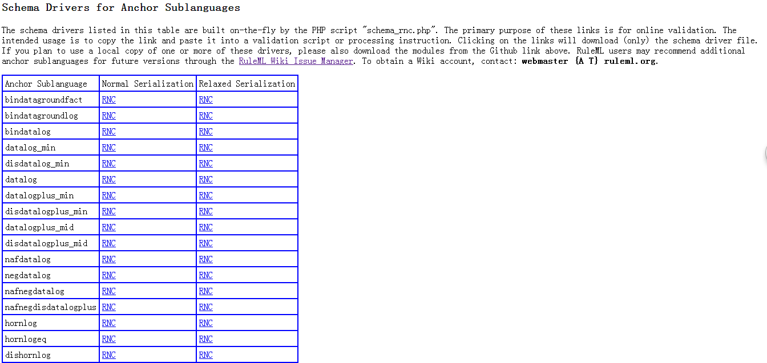
Generate The Hornlog+ Schema
We have already had the Hornlog schema from the link below.
http://deliberation.ruleml.org/1.01/relaxng/

Slide 4
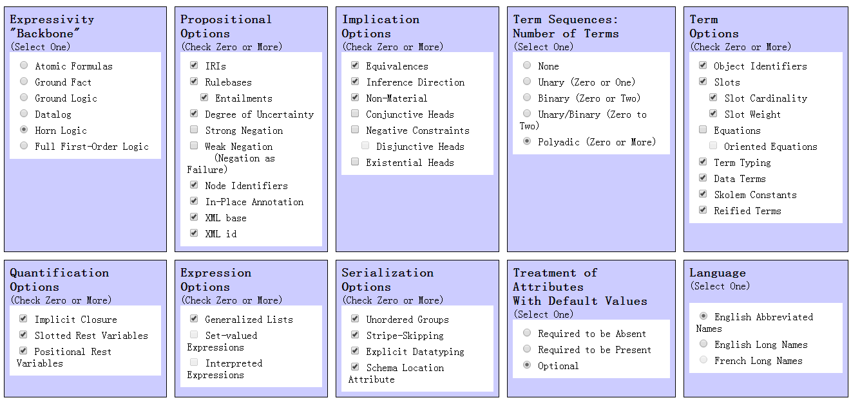
Generate The Hornlog+ Schema
Then we can show the Hornlog schema on the schema selection form.
http://deliberation.ruleml.org/1.01/myng/

Slide 5
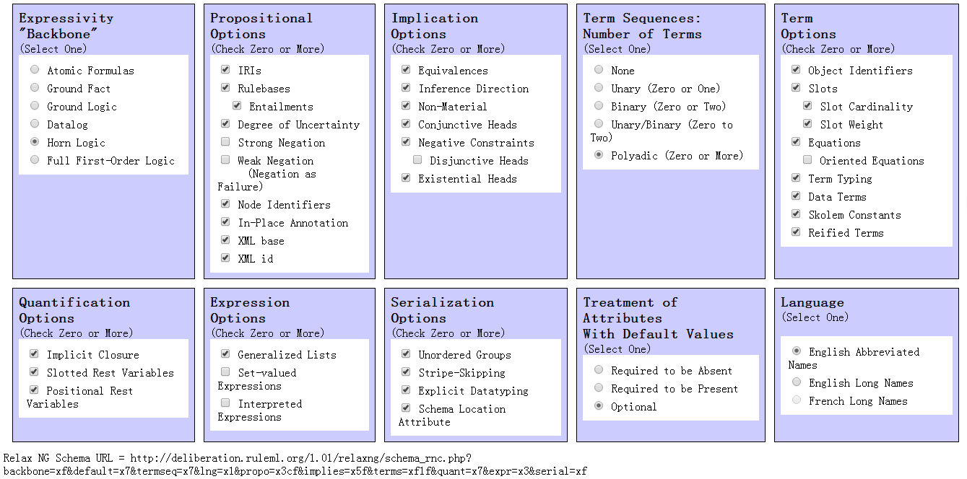
Generate The Hornlog+ Schema
Then we add the features to develop the Hornlog schema to Hornlog+ schema

Slide 6
The Schemas We Generated And Used In Our Project
Datalogplus_min schema:
http://deliberation.ruleml.org/1.01/relaxng/datalogplus_min_relaxed.rnc
Hornlog schema:
http://deliberation.ruleml.org/1.01/relaxng/hornlog_relaxed.rnc
Binhornlog+ schema:
http://deliberation.ruleml.org/1.01/relaxng/schema_rnc.php?backbone=xf&default=x7&termseq=x2&lng=x1&propo=x3cf&implies=x5f&terms=xf1f&quant=x3&expr=x7&serial=xf
Hornlog+ schema:
http://deliberation.ruleml.org/1.01/relaxng/schema_rnc.php?backbone=xf&default=x7&termseq=x7&lng=x1&propo=x3cf&implies=x5f&terms=xf1f&quant=x7&expr=x3&serial=xf
Dishornlog+ schema:
http://deliberation.ruleml.org/1.01/relaxng/schema_rnc.php?backbone=x1f&default=x7&termseq=x7&lng=x1&propo=x3cf&implies=x7f&terms=xf1f&quant=x7&expr=x3&serial=xf
Nafhornlog+ schema:
http://deliberation.ruleml.org/1.01/relaxng/schema_rnc.php?backbone=xf&default=x7&termseq=x7&lng=x1&propo=x3ef&implies=x5f&terms=xf1f&quant=x7&expr=x3&serial=xf
Neghornlog+ schema:
http://deliberation.ruleml.org/1.01/relaxng/schema_rnc.php?backbone=xf&default=x7&termseq=x7&lng=x1&propo=x3df&implies=x5f&terms=xf1f&quant=x7&expr=xf&serial=xf
Nafnegdishornlog+ schema:
http://deliberation.ruleml.org/1.01/relaxng/nafnegdishornlogplus_relaxed.rnc

Slide 7
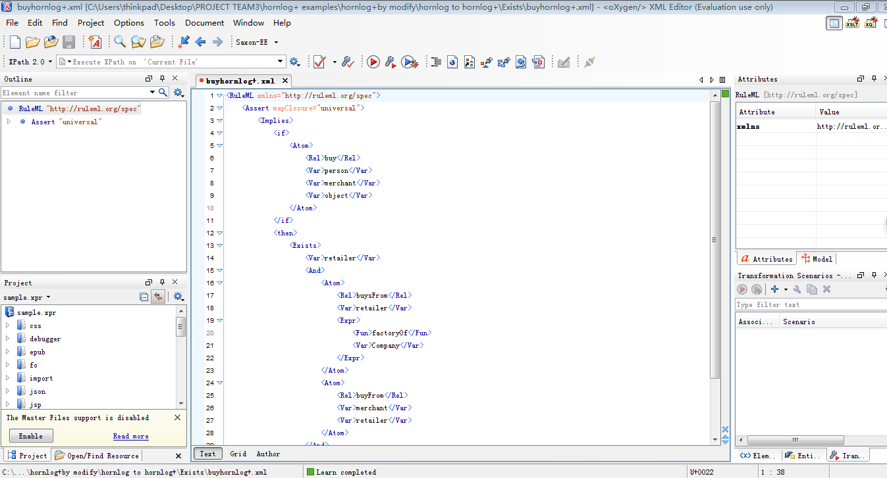
Modifying And Creating Examples With Oxygen

Slide 8
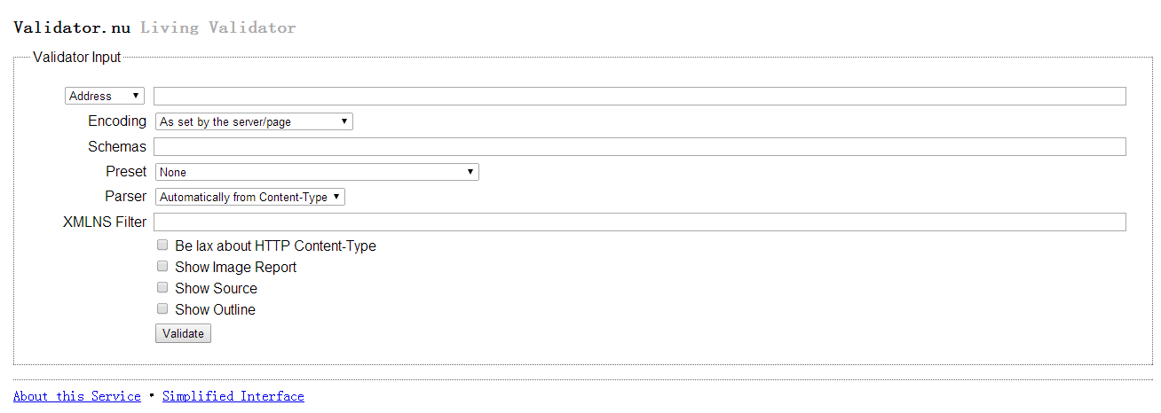
Validating The Examples
We used http://validator.nu/ to validate the example with the corresponding schema.

Slide 9
Validating The Examples
The Hornlog+ schema
The ownhornlog+ example
http://deliberation.ruleml.org/1.01/relaxng/schema_rnc.php?backbone=xf&default=x7&termseq=x7&lng=x1&propo=x3cf&implies=x5f&terms=xf1f&quant=x7&expr=x3&serial=xf
<RuleML xmlns="http://ruleml.org/spec">
<Assert>
<Implies closure="universal">
<if>
<And>
<Atom>
<Rel>buy</Rel>
<Var>person</Var>
<Var>merchant</Var>
<Var>object</Var>
</Atom>
<Atom>
<Rel>keep</Rel>
<Var>person</Var>
<Var>object</Var>
</Atom>
</And>
</if>
<then>
<Exists>
<Var>object</Var>
<Atom>
<Rel>own</Rel>
<Var>person</Var>
<Var>object</Var>
</Atom>
</Exists>
</then>
</Implies>
</Assert>
</RuleML>

Slide 10
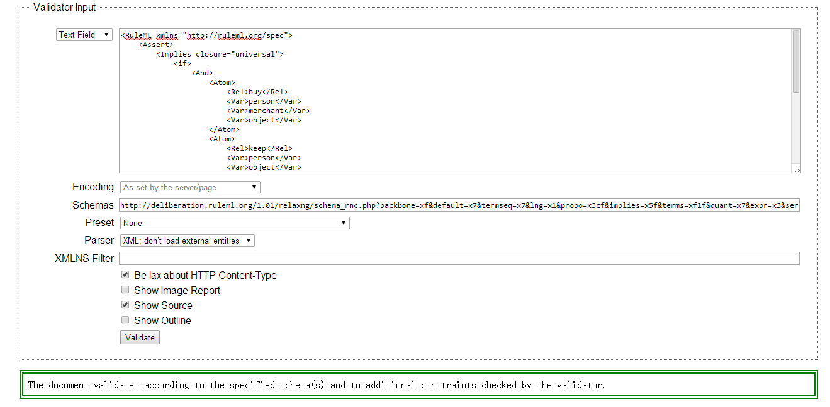
Validating The Examples
The validation result of ownhornlog+ example

Slide 11
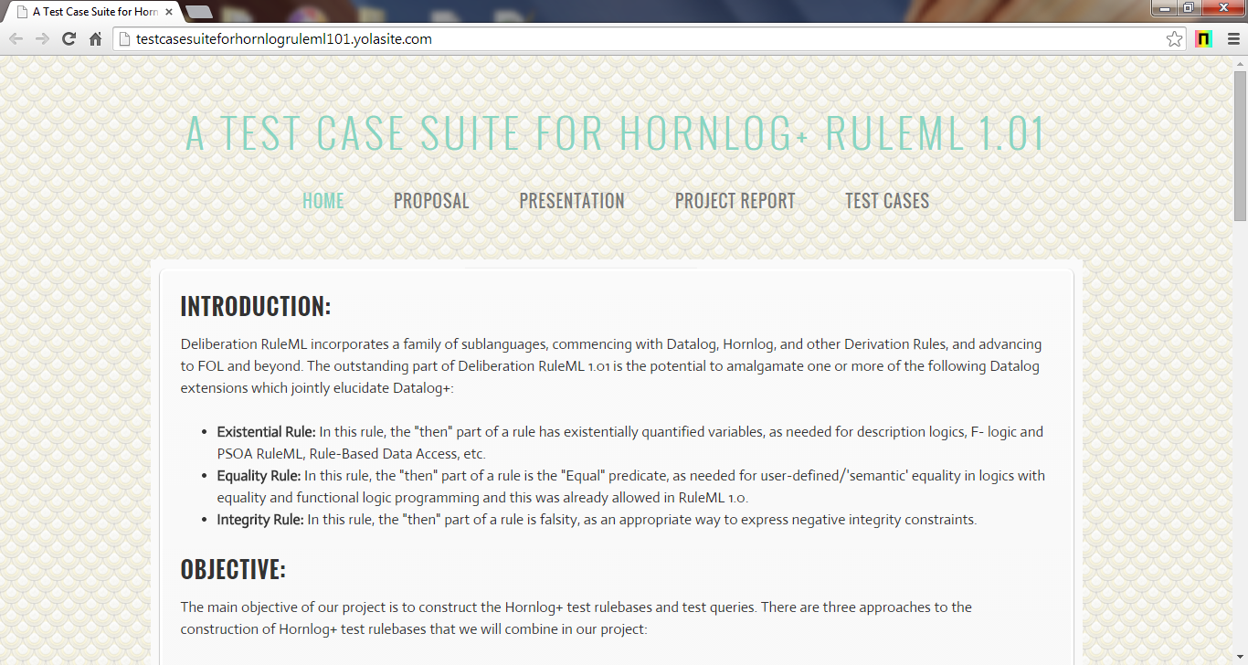
http://testcasesuiteforhornlogruleml101.yolasite.com/

Slide 12
Thank you

